Slide 1
From Signals to Trades
Goodbye savings, hello sadness

Slide 2
The Critical Transition
Last week
We built filters – EMA, RSI, Logic Gates
We tried to encode reason when looking at data
We claimed that if we could see these things, it might be possible to understand them
We have not yet addressed where 90% of trading strategies go to die
Between our if statements and the executed trade lies the real world
Between a signal and our bank account lies the execution gap
This gap is filled with friction: network latency, exchange fees, spread, liquidity
Reality can also changes in microseconds
This week we try to bridge this gap as much as possible
We are also going to actually make trades!

Slide 3
The Three Lies We Believe
MY Code: if RSI <30 THEN BUY
Buy? How much? With what money? At what Price?

Slide 4
Lie #1: Signals are Enough
If RSI < 30 BUY
This is incomplete
Missing context
How much do I buy?
Do I even have money left?
What is my risk tolerance?
What if I already own this stock?
What price is a good deal?

Slide 5
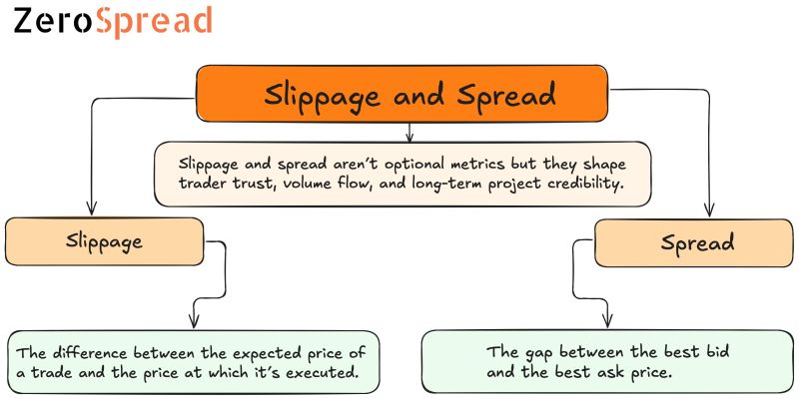
Lie #2: Prices Are Real
My indicator shows NVDA is priced at $150.00!!!
The price we see is often not the purchase price
This confusing notion is described via slippage and spread

Slide 6

Lie #3: Bots are Instant
Our N8N workflow takes 2-5 seconds to execute
Will take longer as we continue to build onto it.
We cannot compete on speed
We know the market moves fast during this time
By the time our order arrives, the world has shifted
In 2010, Spread Networks spent $300 million to drill fiber optic cables through the Allegheny Mountains from Chicago to New York
They shaved off 3 milliseconds
$100 million per millisecond
A high frequency trading firm called jump trading bought a plot of land near the CME data center for $14 million
They built a microwave radio tower to shave 0.07 milliseconds
To be fast and competitive we need a cross-connect physical cable to an exchange
$33,000 a month to rent
Our Budget: $0
Notes:
In 2010, a company spent $300 million digging a tunnel through mountains just to save 3 milliseconds—that is 1/1000th of the time it takes you to blink.
Another firm spent $14 million on a microwave tower to save 0.07 milliseconds.
If Wall Street is willing to spend half a billion dollars to be 0.003 seconds faster than you, do you really think your 'Market Order' is going to get the price you see on the screen?

Slide 7
This week's goal
Build the bridge from signal to actual trade
01
Learn about Orders, Positions
02
Make our first paper trade
03
Understand why we are going to fail
04

Slide 8
Recap From Week 2: What Is A Trade
A trade is an agreement on price, but a disagreement on value.
In the financial world when a person buys something he/she thinks it will go up in price.
The person selling the item thinks it will go down in value.
Whenever a person makes a trade, they decide to enter into the trade and exit out of the trade
The exit is when you eventually sell the stock(hopefully for a profit)
As of ’25, the average daily share volume across all U.S. exchanges sits at around 12 to 18 billion shares
NVDA alone often sees over 170 million shares traded in a single day
60 million individual trades a day
That same purchase of 5,000 shares of Nvidia counts as only 1 trade
This equates to about 10 trillion dollars worth of money changing hands globally each day
We typically see two main categories of trades: Long and Short trades
Notes:
That same purchase of 5,000 shares of Nvidia counts as only 1 trade

Slide 9
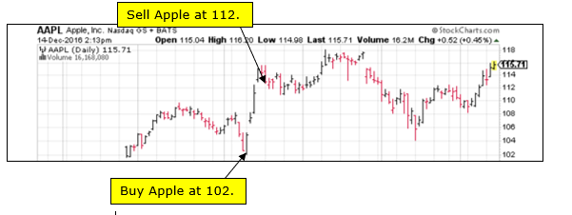
Long Trades
Normally, a person enters a trade by buying something, then exists the trade by selling it to someone else
When you buy to enter and sell to exit this process is called a long trade
A person who has entered a long trade, but has not exited the trade is considered to be in a long position.
This is taken by those who believe a particular stock is going to go up in value
Ie: we buy AMD at $11 a share in 2017, sell it for $213 in 2025 and make about $202 per share

Slide 10
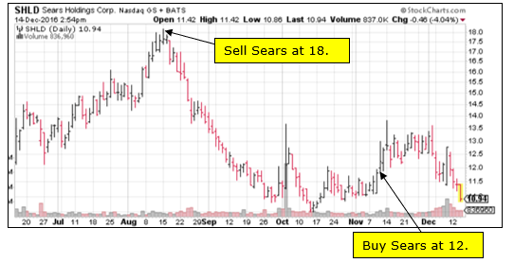
Short Trade
A short trade is when a person enters a trade by first selling something, then exits the trade by buying it back
When you sell to enter and buy to exit this is called a short trade
A person who has entered a short trade, but has not exited the trade is considered to be in a short position
They are taking the stance that a particular stock is going to decrease in value
Say you sell a single share of NVDA stock at $220 and buy it back at $200, even though the stock itself went down 20 points, you still made a profit of $20

Slide 11
Going Short: How can you sell what you don’t own?
A brokerage firm keeps track of all trades you make
In our long trade case, the firm would keep a record of how many shares(+N) you purchased, at what date, at what price
When you exit, they would move your balance back to zero shares(-N)
In our short trade case, the firm would keep a record of how many shares you sold(-N)
When you exit, they would move your balance back to zero shares(+N)
You effectively owe the brokerage N firms that you buy at a later date

Slide 12
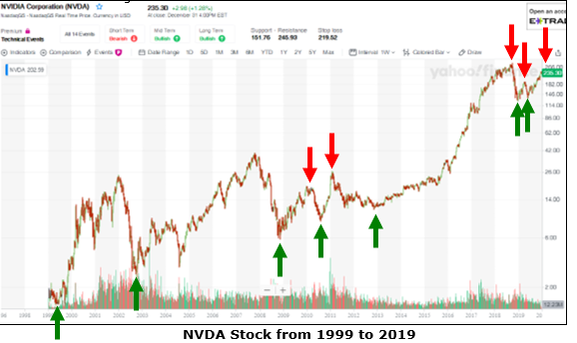
Timing the Market
Day traders attempt(and fail) at trying to time these up and down swings
Yet it is possible to take full advantage of both upward and downward price movements
In a perfect world, you would go long at the green arrows, go short at the red arrows

Slide 13
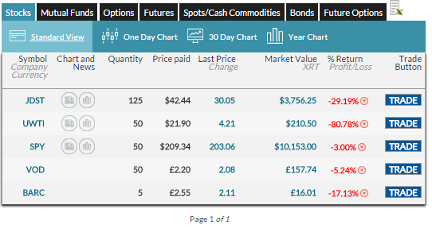
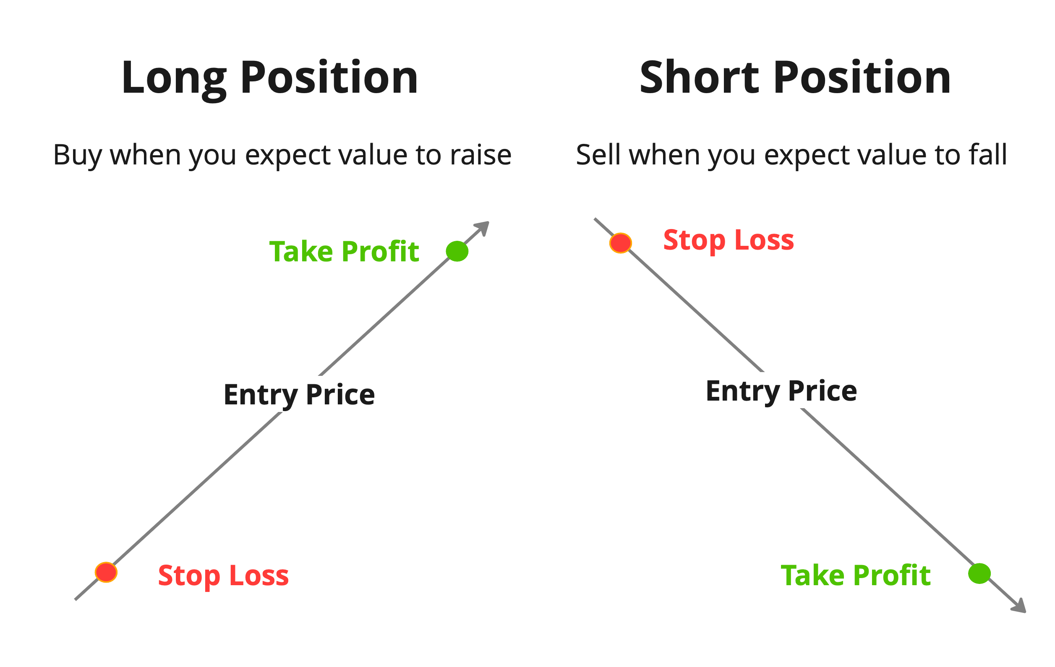
Positions
Position: This is the current holdings you currently have.
It’s what you own right now

Slide 14
Why Positions Matter
Remember:
We are operating in a hostile environment
Moves rapidly
Large amounts of external factors
It’s important we understand our own position
If a buy signal triggers
If we already own 10 shares for some company
Do we buy 10 more?
Do we not do anything?
Do we sell what we already have for a profit?
Contrarian move
This is ultimately encoding decisions our bot must understand and make

Slide 15
NEXT SECTION

Slide 16
Orders are Commitments Under Uncertainty
There are two main types of orders we can place
Market Orders
Limit Orders
Speed vs Certainty

Slide 17
Market Orders
When we place a market order we are screaming buy now
We execute the trade immediately at the current market price
Pros
This is usually guaranteed to fill
Fast execution
Cons
We don’t know the exact price
Slippage risk
We typically use this when we need to get in/out immediately
Could also be used when we are focused on long term positions

Slide 18
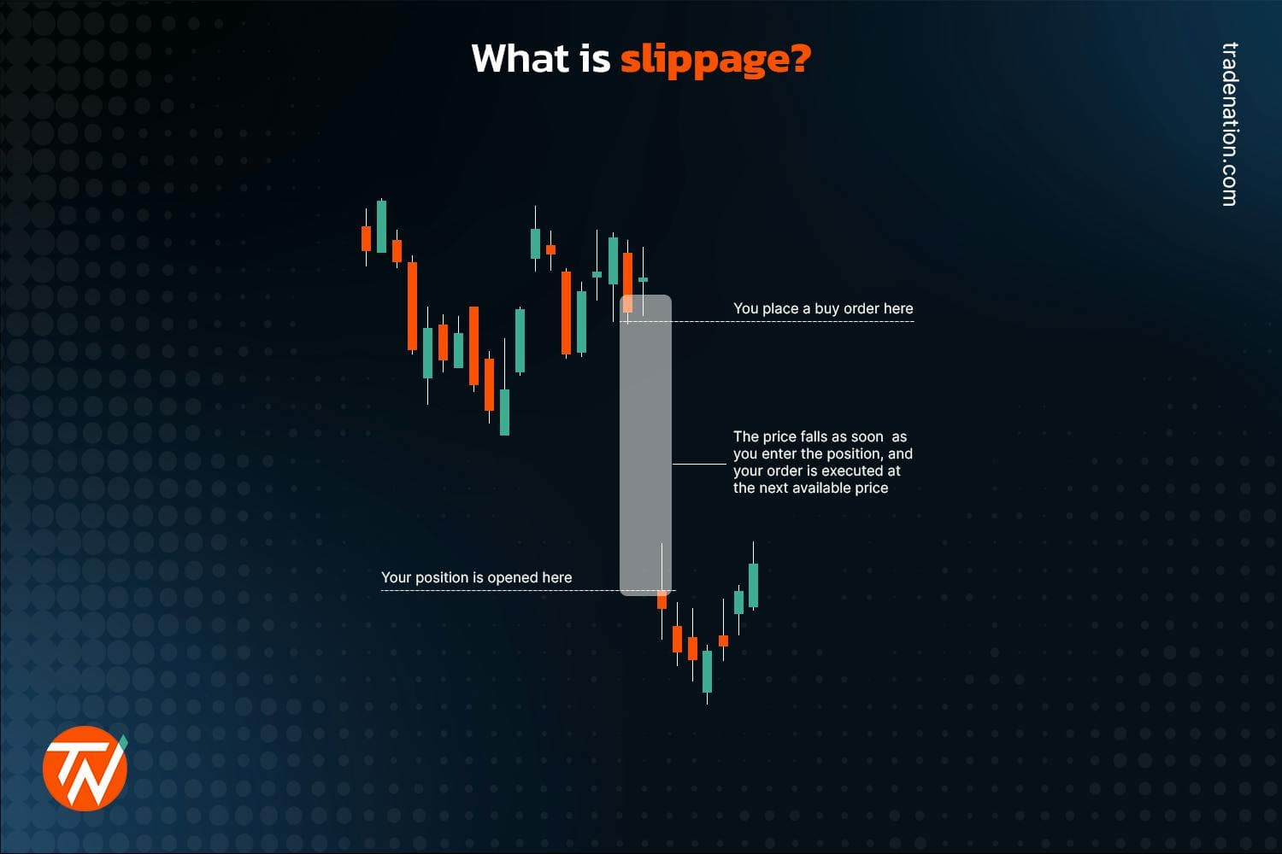
Slippage
Slippage
The gap between the price you expected to trade at and the price your order actually fills at
This is a dynamic cost that arises when your order is filled
Especially common when dealing with rapidly changing prices
Let's pretend you want to buy 10 shares of a stock, and the only other orders in the market are limit orders. Current accepted (bid) price is $4.99, and there are 5 limit sell orders (ask) at $5.00, 3 at $5.01, and 2 at $5.02
You submit a market buy order, expecting to pay $4.99. But because there were no shares on offer for that price, your order bought the shares at the next best prices: 5@$5.00, 3@$5.01, and 2@$5.02 for an average cost of $5.007. Your order 'slipped' from $4.99 to $5.02.

Slide 19
Limit Orders
When we place a limit order we execute only if the market reaches our desired price
Pros
We control the price
No surprise costs
Cons
Might never fill
We could miss the move
Spread risk
We typically use this when we are willing to wait for a specific price as opposed to rushing into something
Say we only want to buy if stock X drops to $55 because we expect it to slowly rebound back up over time and $54.80 is the EMA floor

Slide 20
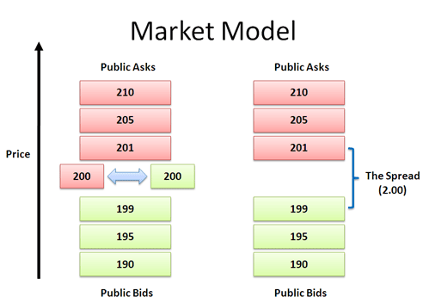
Spread
Spread
There is a constant negotiation between buyers and sellers that creates a spread between the two sides
The difference between the highest price a buyer will pay and the lowest price a seller will accept for an asset
If you want to make an instant purchase, you need to accept the lowest ask price from a seller.
If you'd like to make an instant sale, you'll take the highest bid price from a buyer.

Slide 21
Market Vs Limit: When Each Fails
Market Order Disaster – Low Liquidity (liquidity is the trading volume of some security)
You submit a market order for 100 shares
Only 10 available at $50, next 90 are at $52
Your average fill is $51.80 when we expected $50
Limit Order Disaster – Low Liquidity
We want to buy a given stock with a current price of $100
We set a limit buy at $99.50 because we expect the stock to bounce
The stock immediately runs to $110 and never touches $99.5
We are still sitting on this limit order, in cash, missing the move

Slide 22
The Order Book
The order book is essentially our manager
The price we see on google is the past
It’s the last recorded deal that happened
The order book is reality
It’s the active list of traders waiting to deal on some security
It’s the distilled wall street version of Facebook marketplace
Seller: I want $500 for my PS5
Buyer: I will give you $400
Result: Stare-down – No trade or someone blinks
This gap in the middle is the spread we just talked about
The order book keeps active listings of asks and bids on securities
Notes:
You stand there staring at each other. A trade only happens if one of you blinks.
If you get impatient and say 'Fine, I'll pay $10,000,' you just executed a Market Order. You crossed the spread and paid the Seller's price.

Slide 23
Ask
The Ask is the lowest price a seller is willing to accept for a security right now
The ask represents the supply
It acts as a ceiling because you cannot buy below this price unless a seller panics and lowers their price
When you place a market order you are smashing through this ceiling and simply paying the ask
If we are dealing with a high frequency trading bot, this signifies losing money
If we are dealing with a longer term holding, this matters far less

Slide 24
Bid
The Bid is the highest price a buyer is willing to pay for a security right now
The bid represents the demand
It acts like the floor because the price cannot fall below this level unless all the buyers at that price vanish or are filled
If you want to exit the market immediately you execute a market sell
You hit the sell it now button
You accept the highest offer on the table
Notes:
Imagine you own a rare watch worth $10,000. That is the 'Market Price.'
If you list it on eBay and wait a month, you might get $10,000. That is a Limit Order. You are being patient.
But if you need cash tonight, you go to a pawn shop. They say: 'I'll give you $8,000 cash right now.’
It is lower than the value, but it is immediate. When your bot sends a 'Market Sell' order, it is running to the pawn shop. It is saying, 'I don't care about fair value, I just want out.' And the market charges you for that panic."

Slide 25
Liquidity
liquidity is the trading volume of some security
Ex:
If there are 10,000 shares for sale at $150.05, that is a "Thick Book" (High Liquidity). You can buy a lot without moving the price.
If there are only 5 shares, that is a "Thin Book." Your order will eat those 5 and jump to the next price ($150.10).
This is where Slippage comes back into play

Slide 26
The Real Order Lifecycle

Slide 27
When Orders get Rejected

Slide 28
P&L: The Only Truth
P&L: This is the profit and loss equation
Everything else
Win rate, signals, fancy indicators are vanity metrics
The core reality is
If the P&L is negative, you are losing money
As we evaluate our methods
Are we making or losing money?
Seems like a simple concept
Many traders get lost chasing win rate without considering their losses
Only realize once it’s too late
Many traders also get lost with realized vs unrealized P&L

Slide 29
Realized vs Unrealized P&L
Unrealized P&L
You still own the shares
Paper gains/losses
Changes every second
Not real until you sell
Realized P&L
You close the position
Money in/out of account
Fixed forever
Real money
Notes:
Example: Buy 10 shares at $100 = $1,000 cost Stock now at $110 Unrealized P&L = ($110 - $100) × 10 = +$100 If you sell at $108: Realized P&L = ($108 - $100) × 10 = +$80

Slide 30
The Math of P&L
Unrealized P&L
(current price – entry price) * shares
Ex:
Entry: 10 shares at $100 = $1,000
Current: Stock at $110
Unrealized: ($110 - $100) × 10 = +$100 (you're up 10%)
Ex:
If price drops to $95:
Unrealized: ($95 - $100) × 10 = -$50 (you're down 5%)
Until you sell, these are just numbers on a screen.
How we think about these numbers is important

Slide 31
Percentage Returns Matter More
Scenario A:
$10 profit on $100 = 10%
Scenario B:
$10 profit on $1,000 = 1%
Same dollars, very different performance
In System Design, we don't look at absolute output; we look at Efficiency.
ALWAYS think in %, not $
Remember our idea of normalization
Dollars are "un-normalized" data.
They tell us nothing about performance unless you know the denominator
Percentage are normalized data
They once again allow us to compare a penny stock bot to a bitcoin bot
Notes:
If I told you I made $1,000 yesterday, you might think I'm a good trader.
But if I told you I used $1,000,000 to make that $1,000, you'd realize I actually performed worse than a savings account
Always think in Percentages.
Also, look at the chart on the right. Percentages reveal the 'Math of Ruin.' If your bot loses 50% of its cash, it doesn't need a 50% gain to get back to even. It needs a 100% gain.
Digging out of a hole is twice as hard as falling in. That is why we obsess over Risk Management."

Slide 32
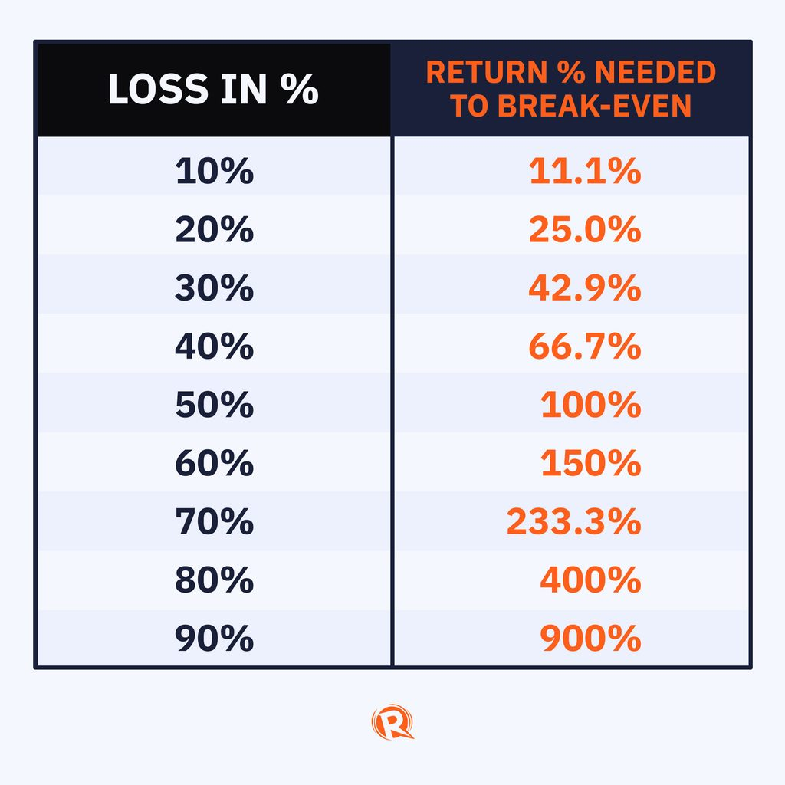
The Brutal Math of Losses
The asymmetry of recovery:
Start: $10,000
Lose 50% → $5,000
Need to recover: +100% (not +50%)
The asymmetry of recovery:
Start: $10,000
Lose 75% → $2,500
Need to recover: +300% (not +75%)
Notes:
Losses hurt more than gains help
- This is why risk management exists

Slide 33
Cumulative P&L
This is the way we monitor our holdings
It’s the active trading ledger noting all our gains/losses based on our starting position
Trade 1: SPY +$50
Trade 2: AAPL -$30
Trade 3: NVDA +$20
Trade 4: TSLA -$100
------------------------------
Cumulative: -$60
This running total determines if our strategy works
One big loss can erase many small wins

